Slide 1

Navigating Public Health Choices: A Diabetes Intervention Framework
This presentation outlines a Python-based decision analysis framework designed to evaluate public health intervention programs. Our goal is to identify the most effective strategies for reducing diabetes cases within a city, ensuring optimal use of resources and maximizing positive health outcomes.

Slide 2
Overview
A Data-Driven Approach to Public Health Interventions
Decision Trees
Expected Value Calculations
Constraint-Based Optimization
Visualizing possible outcomes and choices to guide strategic planning.
Quantifying potential benefits for each program under uncertainty.
Identifying the best program combinations given real-world limitations.
Our framework employs advanced analytical techniques to provide a robust evaluation of various public health programs, offering clear, data-driven recommendations to policymakers.

Slide 3




Key Programs Under Evaluation
Media Campaign
Community Program
Gym & Nutrition Subsidy
City Health App
Cost: $2.5 Billion
Cost: $1.8 Billion
Cost: $0.3 Billion
Variable outcomes based on public engagement levels.
Outcomes vary with community participation rates.
Cost: $0.5 Billion
Fixed outcome: 450 diabetes cases reduced.
Fixed outcome: 950 diabetes cases reduced.

Slide 4
Understanding Engagement and Outcome Data
Engagement Probabilities
Outcome Distributions
For programs like the Media Campaign and Community Program, success hinges on public engagement, categorized into three levels:
Beyond engagement, each level can lead to various outcomes, each with its own probability:
Signifikan (Significant change)
Rendah (Low)
Minor (Minimal change)
Sedang (Medium)
Tidak Ada (No change)
Tinggi (High)
Outcomes are measured by the number of diabetes cases reduced and classified by their impact.
Each level carries distinct probabilities, critical for accurate forecasting.

Slide 5



Question A: Expected Value Calculation
This component computes the Expected Value (EV) for each stochastic program, providing a clear metric of anticipated impact per dollar invested.
Total Expectation
Weighted EV
Efficiency Metrics
Applying the law of total expectation across all engagement levels.
Calculating weighted EV for each specific engagement scenario.
Providing EV per billion dollars invested, highlighting cost-effectiveness.

Slide 6
Expected Value Calculation Results
Our detailed analysis quantifies the potential impact of each intervention, providing critical insights into their cost-effectiveness and expected outcomes.
Media Campaign Analysis
Community Program Analysis
Low (Rendah)
0.3
52.5
15.75
Low (Rendah)
0.25
100.0
25.00
Medium (Sedang)
0.5
490.0
245.00
Medium (Sedang)
0.35
865.0
302.75
High (Tinggi)
0.2
1010.0
202.00
High (Tinggi)
0.40
1430.0
572.00
Total Expected Value: 462.75 cases
Total Expected Value: 899.75 cases
Investment Cost: $2.5 Billion
Investment Cost: $1.8 Billion
EV per Billion: 185.10 cases
EV per Billion: 499.86 cases

Slide 7
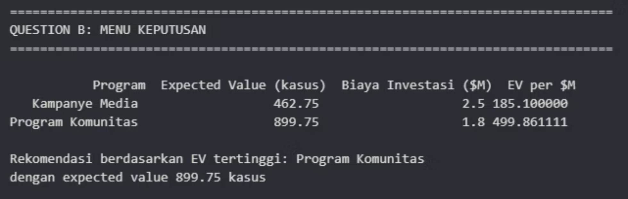
Question B: Decision Menu - Comparative Program Summary
The Decision Menu offers a concise overview, facilitating quick comparisons and informed decision-making based on efficiency and expected impact.

Slide 8
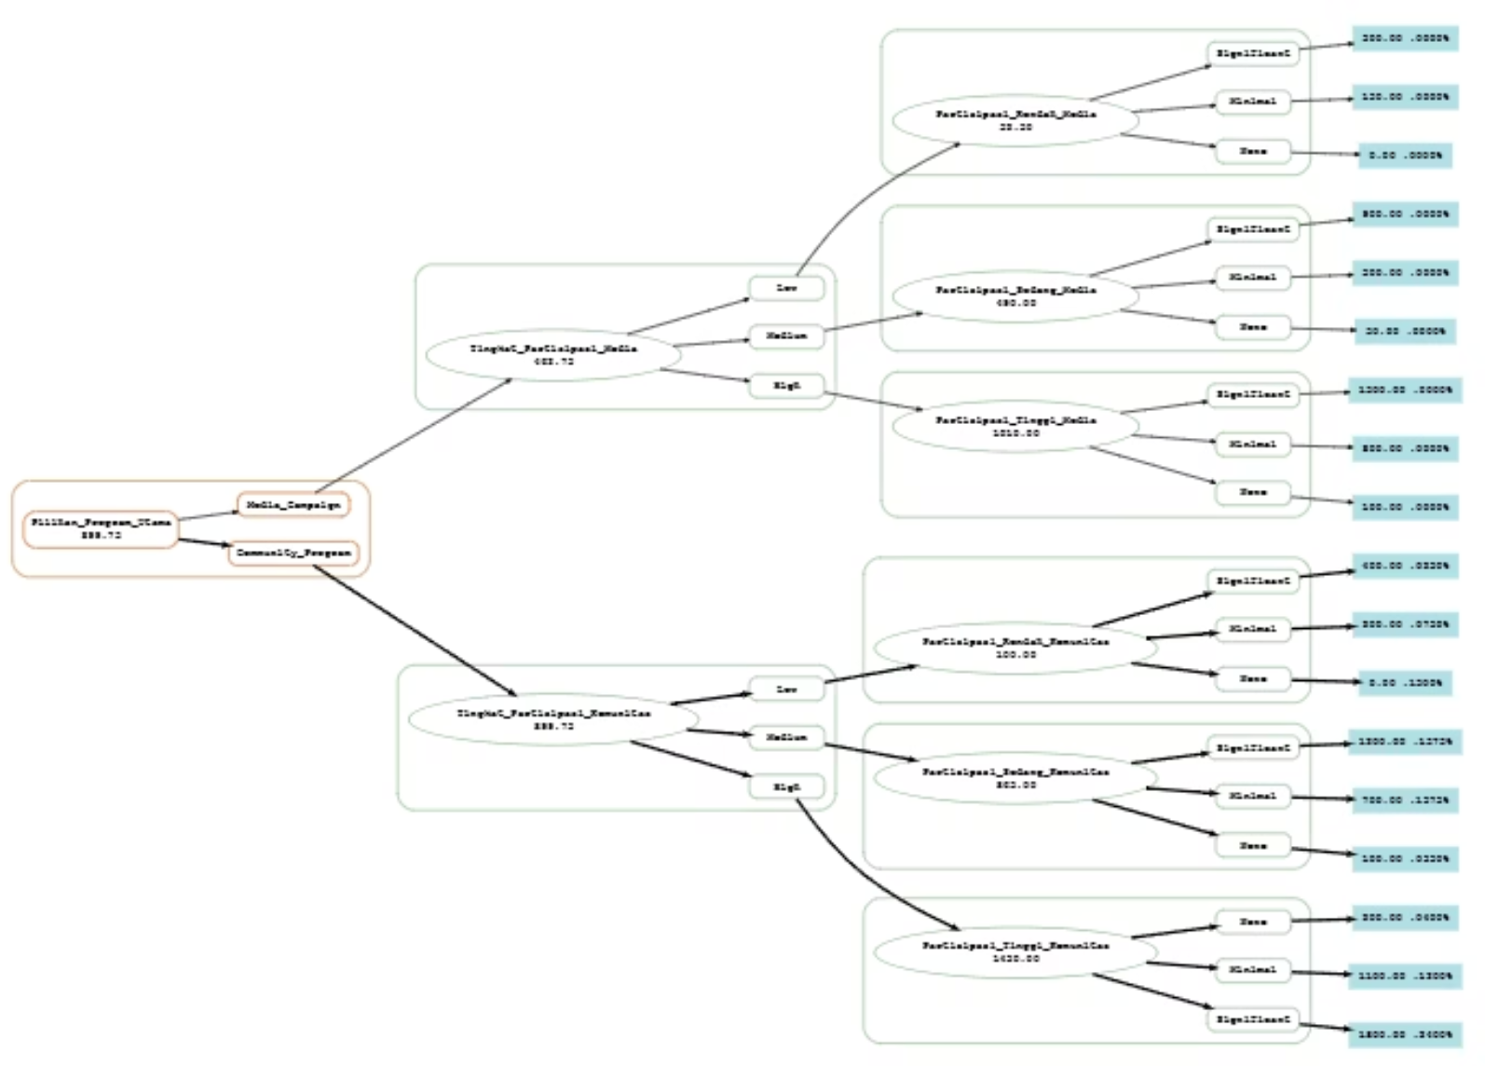
Question C: Decision Tree Analysis (DADT)
A comprehensive decision tree provides a visual and analytical tool for understanding the potential outcomes of choosing between major programs, like the Media Campaign vs. Community Program.
The tree's automated rollback algorithm computes the optimal strategy by evaluating expected values at each node, identifying the single most beneficial program.

Slide 9




Question D: Optimal Program Combination
Beyond individual programs, identifying the best combination of interventions is crucial for maximizing impact within given constraints.
Budget Constraint
Capacity Constraint
Total cost must not exceed $5 Billion.
Maximum of 2 programs simultaneously.
Dependency Constraint
Exclusivity Constraint
Gym Subsidy requires the Media Campaign.
Media Campaign and Health App cannot coexist.

Slide 10








Optimal Solution Results
After a thorough analysis of all valid combinations, our framework identified the most effective strategy for diabetes intervention, along with key performance indicators.
Analysis Scope
Optimal Choice
Impact
6 valid combinations were found and analyzed
The optimal combination is: Media Campaign + Gym & Nutrition Subsidy
Total Expected Value: 1,412.75 cases reduced
Investment
Efficiency
Total Investment Cost: $3.00 Billion
Efficiency: 470.92 cases per $Billion
Top 3 Combinations
Media Campaign + Gym & Nutrition Subsidy
Media Campaign + Community Program
Community Program + City Health App
1,362.50 cases, $4.30B, 316.86 cases/$B
1,349.75 cases, $2.10B, 642.74 cases/$B
1,412.75 cases, $3.00B, 470.92 cases/$B

